Slide 1

Mifos: Ending Poverty One Line of Code at a Time
Humanitarian FOSS track
at the Open World Forum
Paris; October 12th, 2012

Slide 2
$ ls ~/presentation/
About Microfinance & About Mifos
  Very short introductions
  Full disclosure: Repeat from last year! ;)
Mifos.org Transition
grameenfoundation.org → openmf.org
Mifos X The Next Generation (TNG)
How YOU can contribute
Q & A
Updated Content provided by Ed Cable, Mifos Community Manager & Keith Woodlock (thanks!)

Slide 3
$ whoami
Volunteer for Mifos approx. 2009-2011, time permitting
(java.net / mifosforge.jira.com + Wiki migrations; Workspace 2.0; Executable WAR; small bug fixes)
Day job as product manager at TEMENOS The Banking Software company, looking after an IDE built with (and small contributions back to) open source Eclipse Java Modeling Frameworks. GIVING THIS PRESENTATION IN PRIVATE CAPACITY ON A DAY OFF.
Lives & works in Lausanne, Switzerland.
http://vorburger.ch ● mike@vorburger.ch ● @vorburger
https://delicious.com/vorburger
https://github.com/vorburger
http://blog2.vorburger.ch

Slide 4
$ file /poverty – hello, world
Of total world population of 6.8 billion:
  880 million survive on less than USD 1/day (13%)
  1.4 billion survive on less than USD 1.25/day (20%)
  2.6 billion survive on less than USD 2/day (40%)
International “Poverty Line” = USD 1.25 / day (so 33%)
Source: World Bank Development Indicators 2008
http://en.wikipedia.org/wiki/Poverty#Absolute_poverty
en.wikipedia.org/wiki/Theories_of_poverty#Poverty_as_restriction_of_opportunities

Slide 5
$ man microfinance
Microfinance, a proven poverty reduction strategy, provides financial services to very low-income “unbanked” clients, who lack access to “traditional” banking services (only “loan sharks”), to “help them to help themselves”, to:
  Smooth irregular income flows
  Provide cushions for emergencies
  Expand economic activities

Slide 6
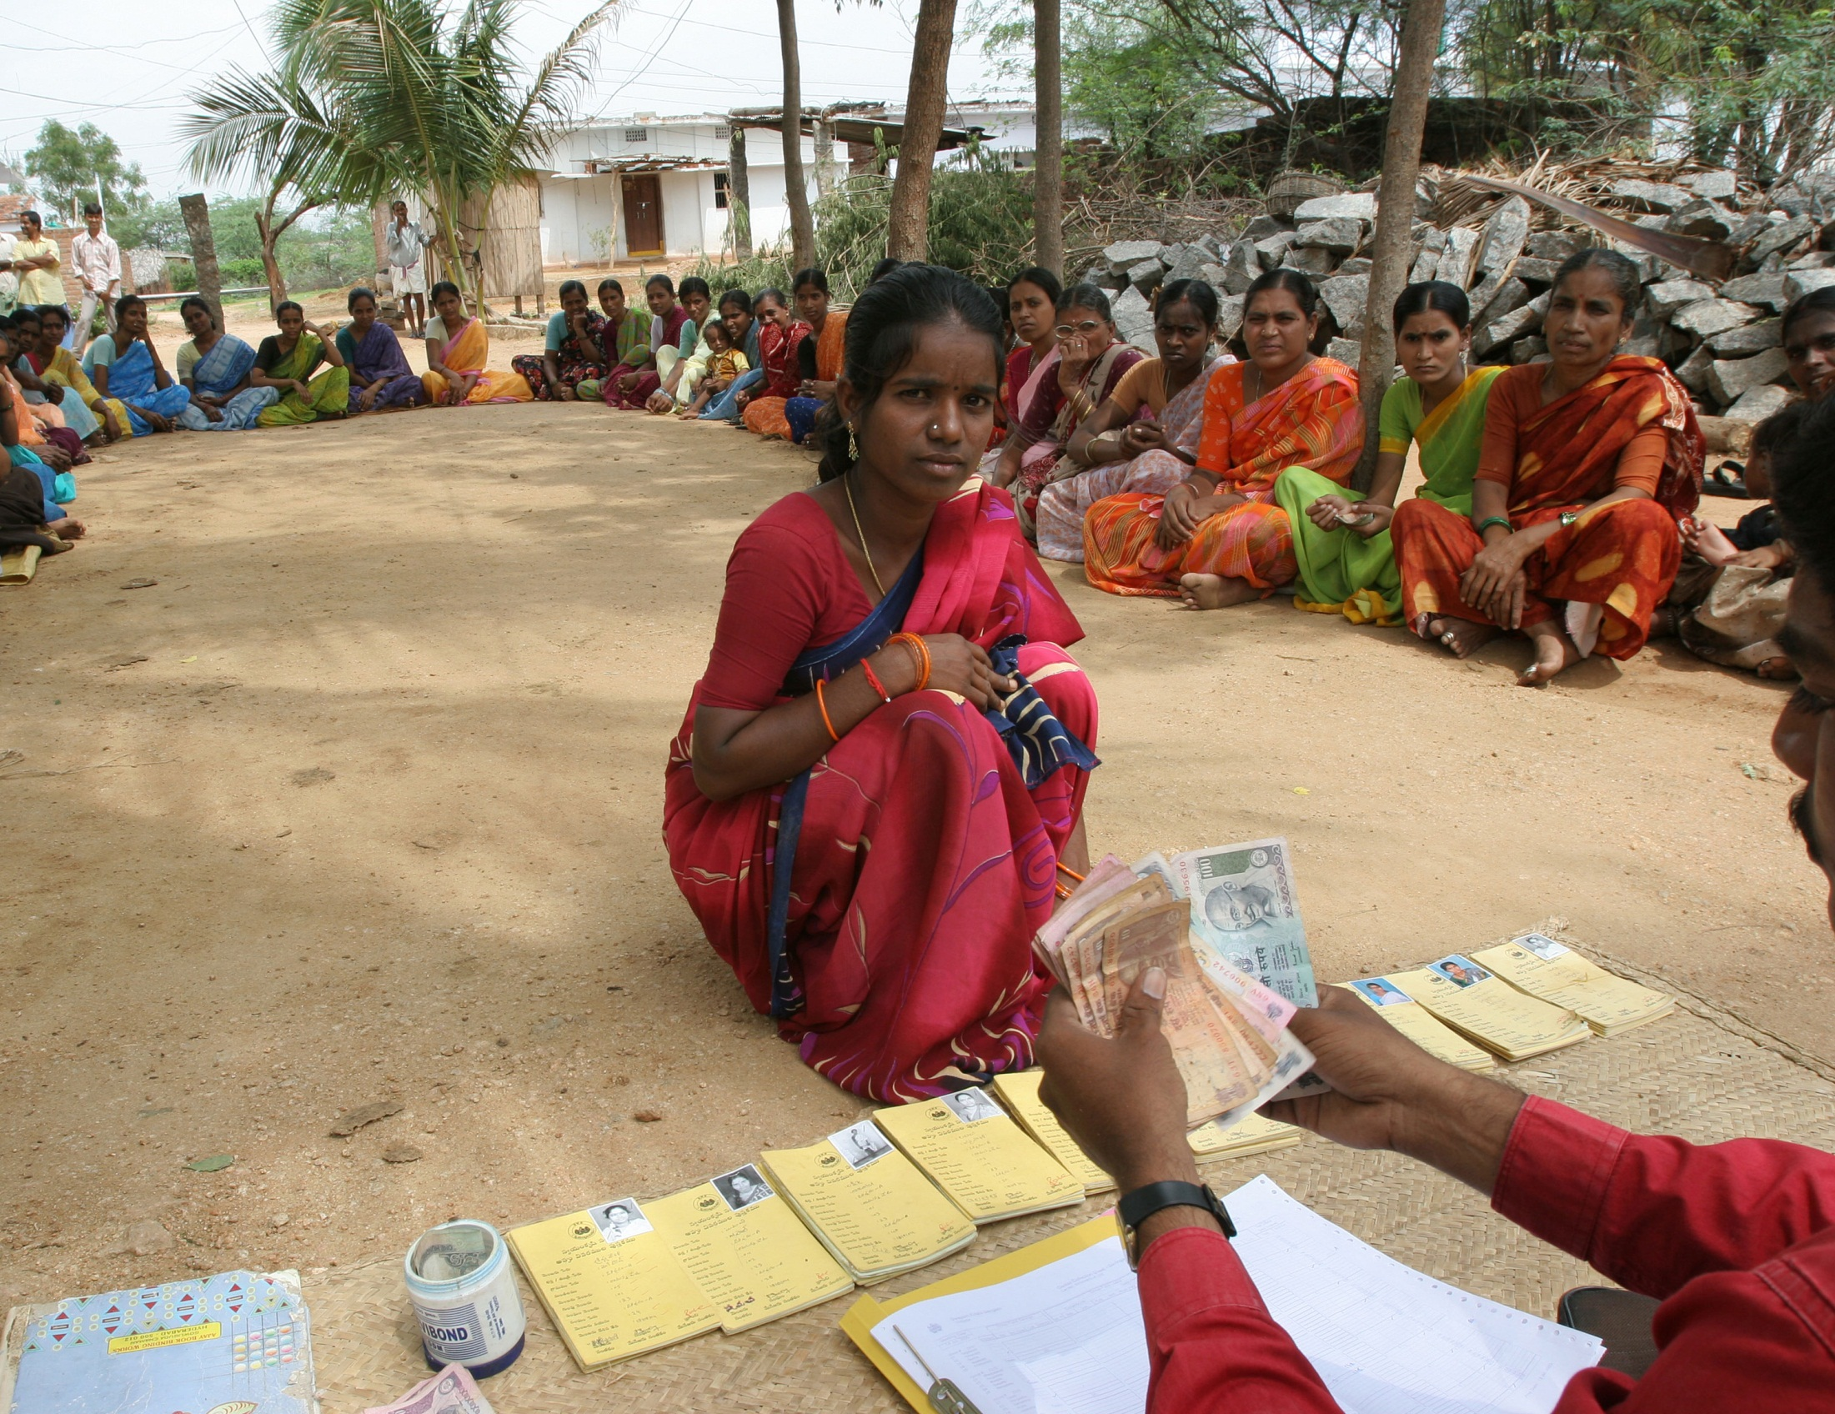

Slide 7
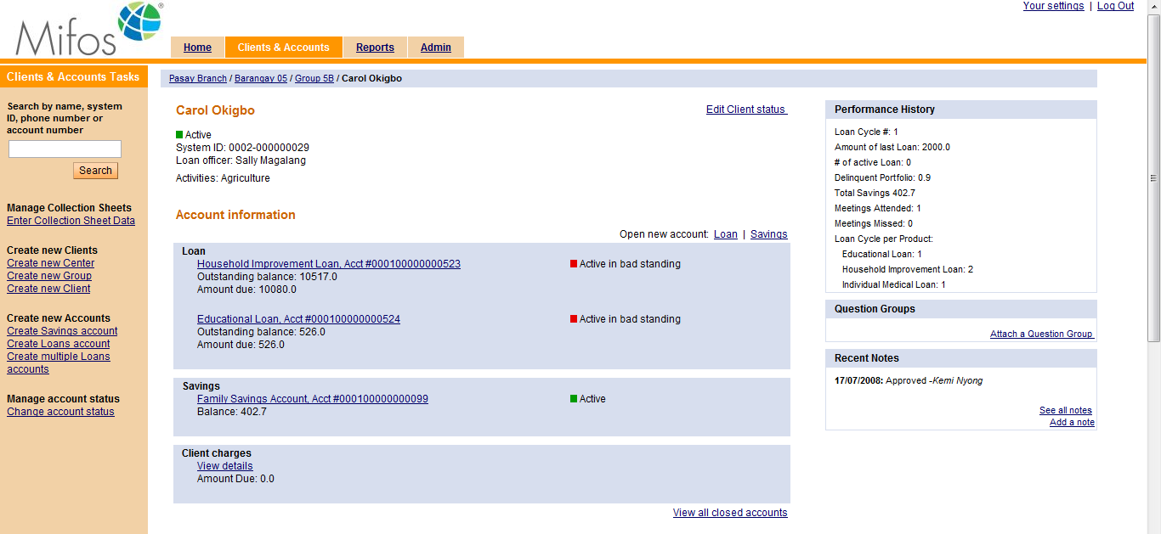
$ man mifos
Mifos “Technology that accelerates Microfinance” is an Open Source platform for Microfinance Institutions. Built on leading open source technologies incl. Java, mySQL (or MariaDB), Spring, Pentaho etc.

Slide 8
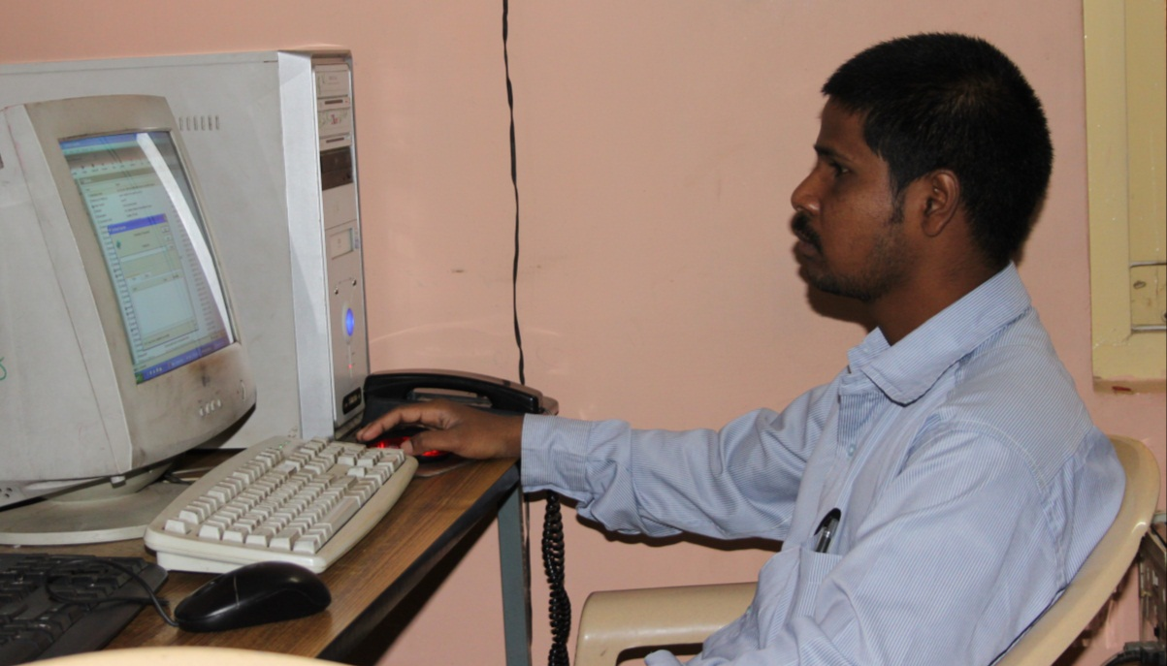
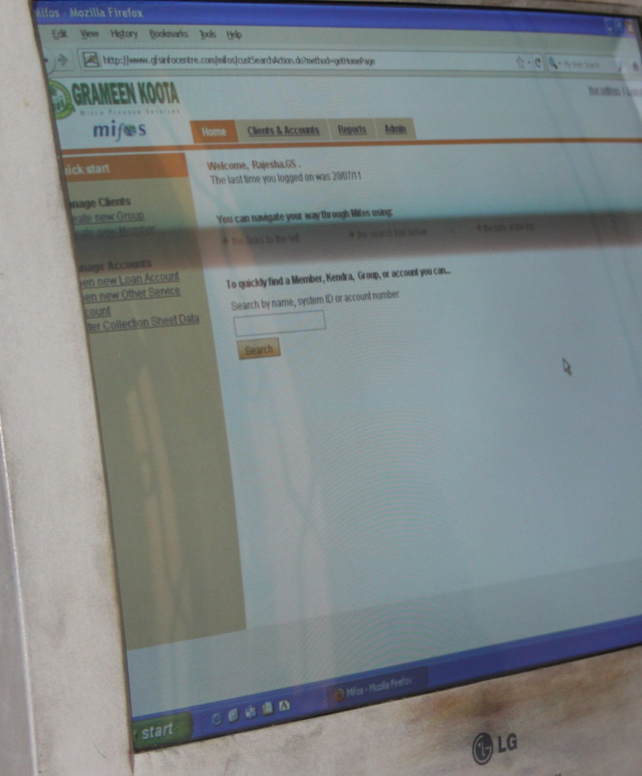
Data Entry officer (Mifos)
Banashankari Branch Office
Grameen Koota (GK)
Bangalore
India

Slide 9


Mifos Stats
  2004–11-19: registered on SourceForge
  2006-11: Official Launch and Initial Release at Halifax Global Summit
  2009 : Winner of JavaOne 2009 Duke's Choice Award
  for Best Java Technology for the Open Source Community
  2009/2010: Google Summer of Code (2009 & 2010) student programs
  2010 Status
    8870 Product Downloads
    2906 volunteer hours from 25 volunteers
    Software in use by 30 MFI serving 850,000 clients.
  2011: Grameen Foundation transitioned Mifos
  to a fully independent community-led project.
About 256 database tables
according to SchemaSpy job on http://ci.mifos.org/schema/head/latest/
About 120'000 Lines of Code (NCSS, Non Commenting Source Statements)
according to Sonar report on http://ci.mifos.org:9000/project/index/1

Slide 10
Mifos transitions from Grameen Foundation to openmf.org
“Grameen Foundation will be working closely with leaders in the Mifos® community to transition the initiative to an independent, community-driven open-source project. By the end of November, Grameen Foundation's direct involvement with Mifos will conclude.”
Newly formed “Community for Open Source Microfinance” (non-profit) is the new “Mifos” legal entity, under the umbrella of the Software Freedom Conservancy. Mifos IP is owned by conservancy.
Some new funding found to transition, and invest into TNG.

Slide 11
Mifos since Transition
Successful year, community kept growing and is engaged: Bi-weekly user calls, with more than a dozen on each call sharing their experiences. Feedback shapes Roadmap, incoming feature requests that transparently discussed and prioritized.
Mifos Implementation Specialists are more involved - pro-actively going after larger deals, partnering together to collaborate, sharing product requirements.
But we're only partially along the journey... external contribution is still a barrier - that's why Mifos X. The release in 2012 while larger, and guided by a smaller, lower cost team, are still primarily developed by the "core" team.

Slide 12
Mifos since Transition
New major releases: Pentaho integration (incl. Administrative Documents), Android Mobile Client, Excel Import, Accounting Module, Role-Based Permissions for Question Groups, REST API improvements, etc.
First Community Summit – next week in Bangalore!
3 days, http://www.openmf.org/2012-mifos-summit/,
Roadmap discussions, contribution education, visits.
Since the transition to an independent, community-driven project without GF, contributions by both funded developers and volunteers keep coming:

Slide 13
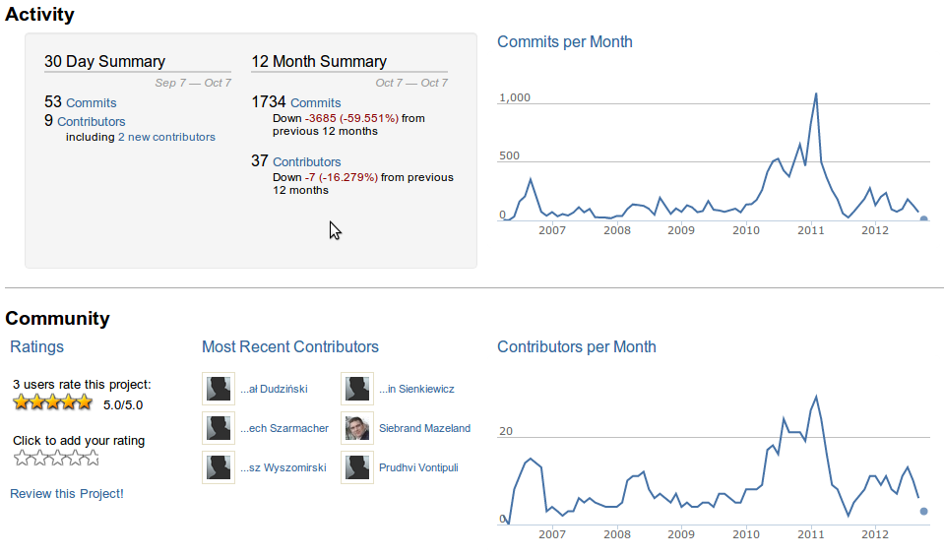
https://www.ohloh.net/p/mifos

Slide 14
Mifos X The Next Generation
Reimplementation for a faster, lighter and cheaper to change Mifos, so that it is more responsive to the needs of MFI’s and Integrators.
Clean split between back-end with RESTful HTTP API (“platform”) and modern HTML / jQuery JS UI. Multi-Tenant Hosting support. Security.
(Re)try to enable an eco-system of providers, located near to the MFIs, that could leverage core Mifos and build their solution for MFIs, for wider Mifos adoption.
Two MFIs using it in near production and then halfway to pilot with three other MFIs. Couple of Developers.

Slide 15
How YOU can contribute!
git clone https://github.com/mifos/head.git
git clone https://github.com/keithwoodlock/mifosx.git
https://mifosforge.jira.com/wiki/display/MIFOS/Workspace+2.0
https://mifosforge.jira.com/wiki/display/MIFOS/Mifos+Version+Control+Guide
Pick a bug! Ask on the mailing list!https://mifosforge.jira.com/secure/Dashboard.jspa?selectPageId=10200

Slide 16

$ wget …mifos…
Learn more:
  http://mifos.org/
  http://bit.ly/mifos-video Mifos In Action Intro. Video
  http://mifosforge.jira.com & http://bit.ly/mifos-volunteer-bugs
  Demo: http://demo.mifos.org/mifos/ (mifos / testmifos)
Get in touch!
Mailing List - http://mifos.org/community/communications
Twitter - @mifos – http://twitter.com/mifos
Facebook – http://facebook.com/mifos.org
News – http://mifos.org/community/news
IRC - #mifos on irc.freenode.net
●

Slide 17
Q & A

Slide 19
$ backup
The following slides are from the original OWF 2011 presentation.

Slide 20
$ man microfinance
Microfinance Institutions (MFI) lend ~ $100-ish amounts (e.g. 12’000 INR), repaid / collected in (bi)weekly over 12/18/24 months, so in 36/50-100 installments.
Microcredit customers are often women only (by MFI choice); money used for things such as bangles shop, family painting business, etc.
Loan Officers go out to meet clients, typically (bi)weekly to collect repayments. Customers don’t come to branch offices to deposit or withdraw. LOs bring the collected money to BOs (and, in some cases, stay and sleep there!)
Typically ~ 98% loan repayment (recovery) rate; e.g. Nirantara in Karnataka/India 99.6% (of 7000 clients with 20’000 Loans)

Slide 21
$ man microfinance
Solidarity Lending (Joint Liability model) is common, creating a bond among a Group of clients. - Centers are sets of Groups, managed by a few LOs in a local Branch, org. by Areas. Groups rural, meetings at e.g. group leader home, or a temple or community site; branches few rooms in small towns.
Products offered depend on country and respective regulations: In e.g. India today often only Loans, rarely Savings Deposit, but in e.g. the Philippines Savings accounts is more common. Growing trend towards broader financial services, incl. microinsurance (often life, some health), pensions, etc.
Typically tied to an “educational” programs: Week long Compulsory Group Training (CGT) introduction loaning; also “stories” read out at each group meeting, e.g. reg. infant hygiene.

Slide 22
$ man microfinance
MFIs vary significantly in scale and reach: from small NGOs (100s of clients) to mid-size non-profits (tens or hundreds of thousands; e.g. Grameen Koota [GK] in India using Mifos on >500’000 Clients), to for-profits (e.g. publicly listed [non-Mifos] SKS Microfinance in India).
Interest rates in the 20–30% range. MFIs typically borrow from traditional banks at around 8% - 12% interest (India); adding on top of it their operating costs, which are higher due to shorter collection cycles and almost “doorstep service”.
  http://en.wikipedia.org/wiki/Flat_rate_%28finance%29
  http://www.mftransparency.org/
Challenges incl. (e.g. in India) regulatory uncertainty (Maligam report), or overheating with “too many loans” by competing MFIs and increasing defaulting problems (compounded by lack of Gov. ID)

Slide 23
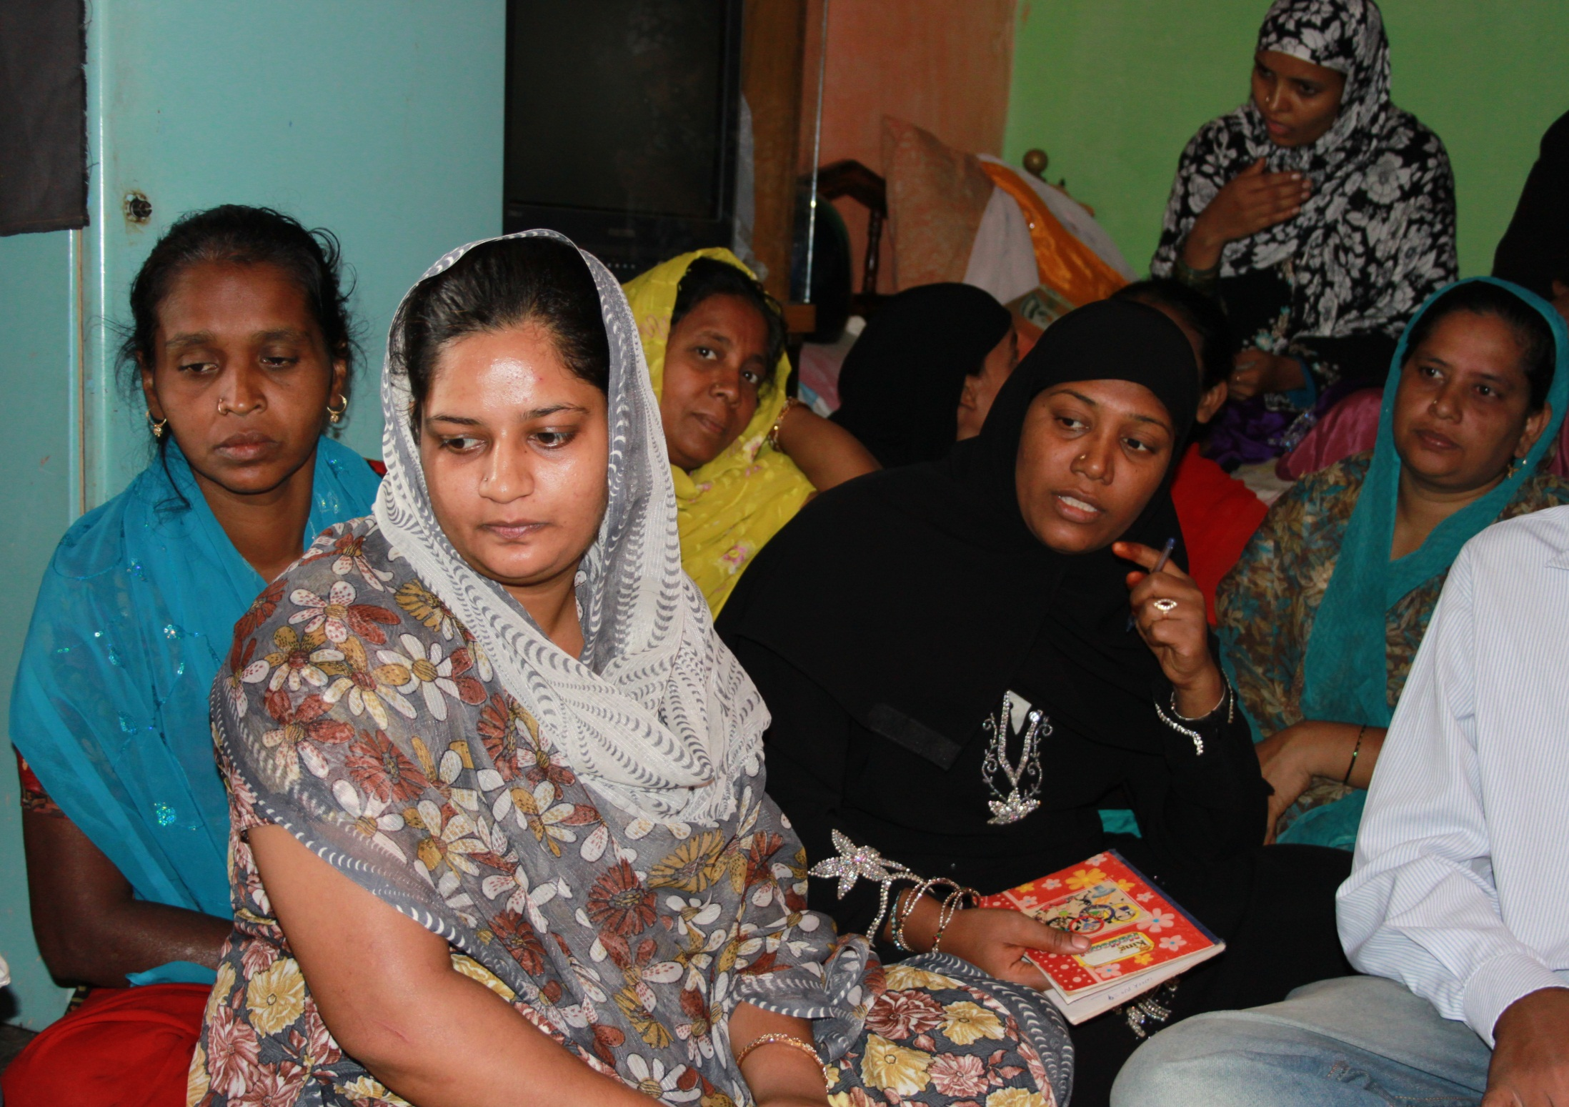
… group meeting (GK)

Slide 24
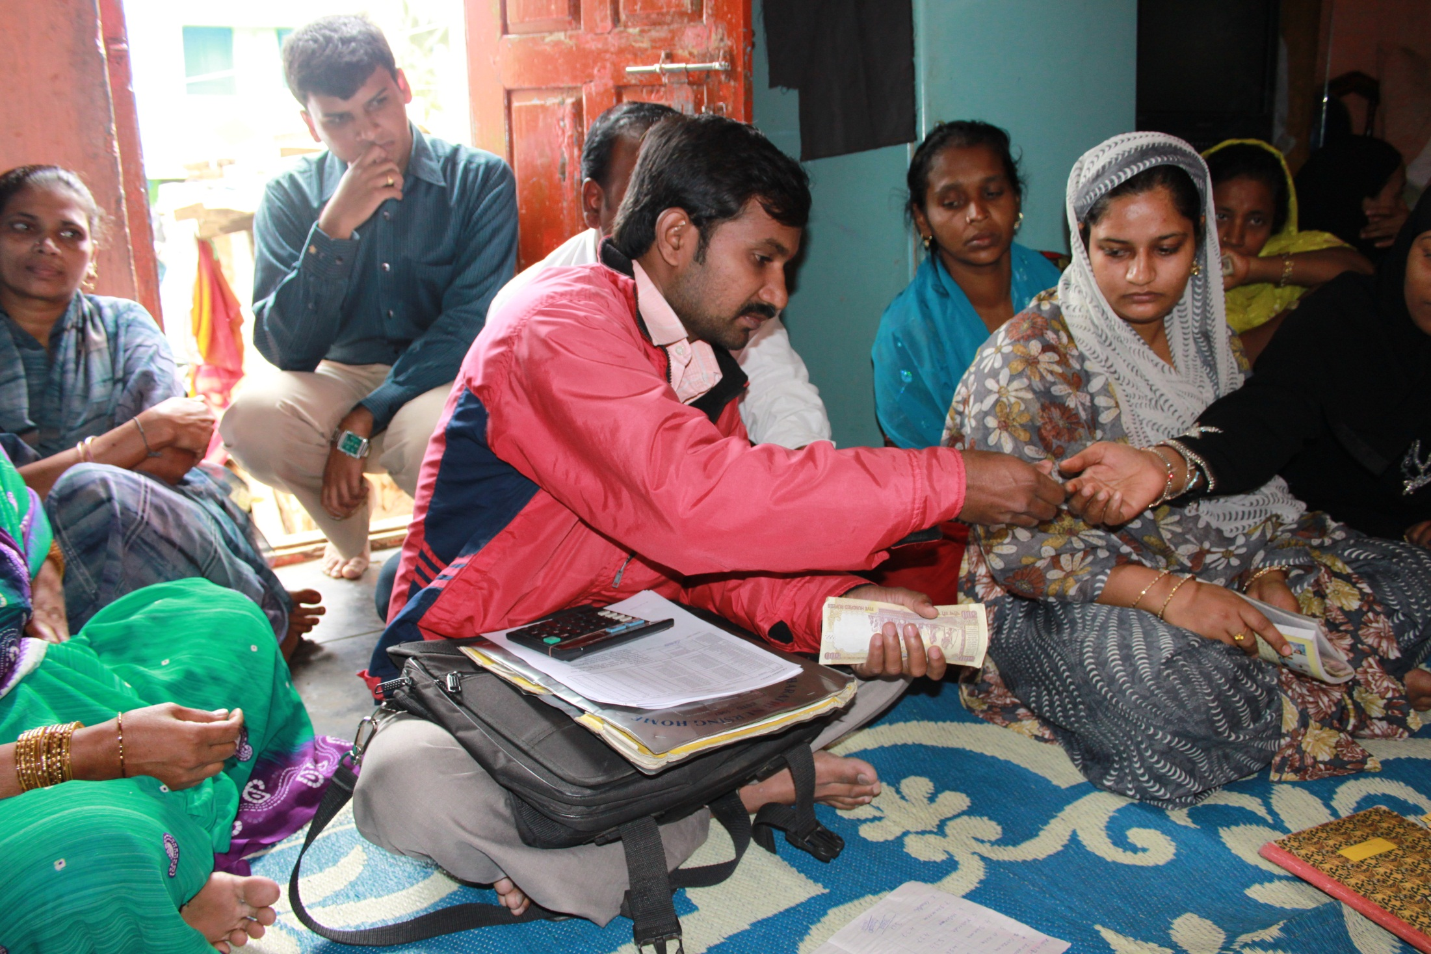
… group meeting (GK)

Slide 25
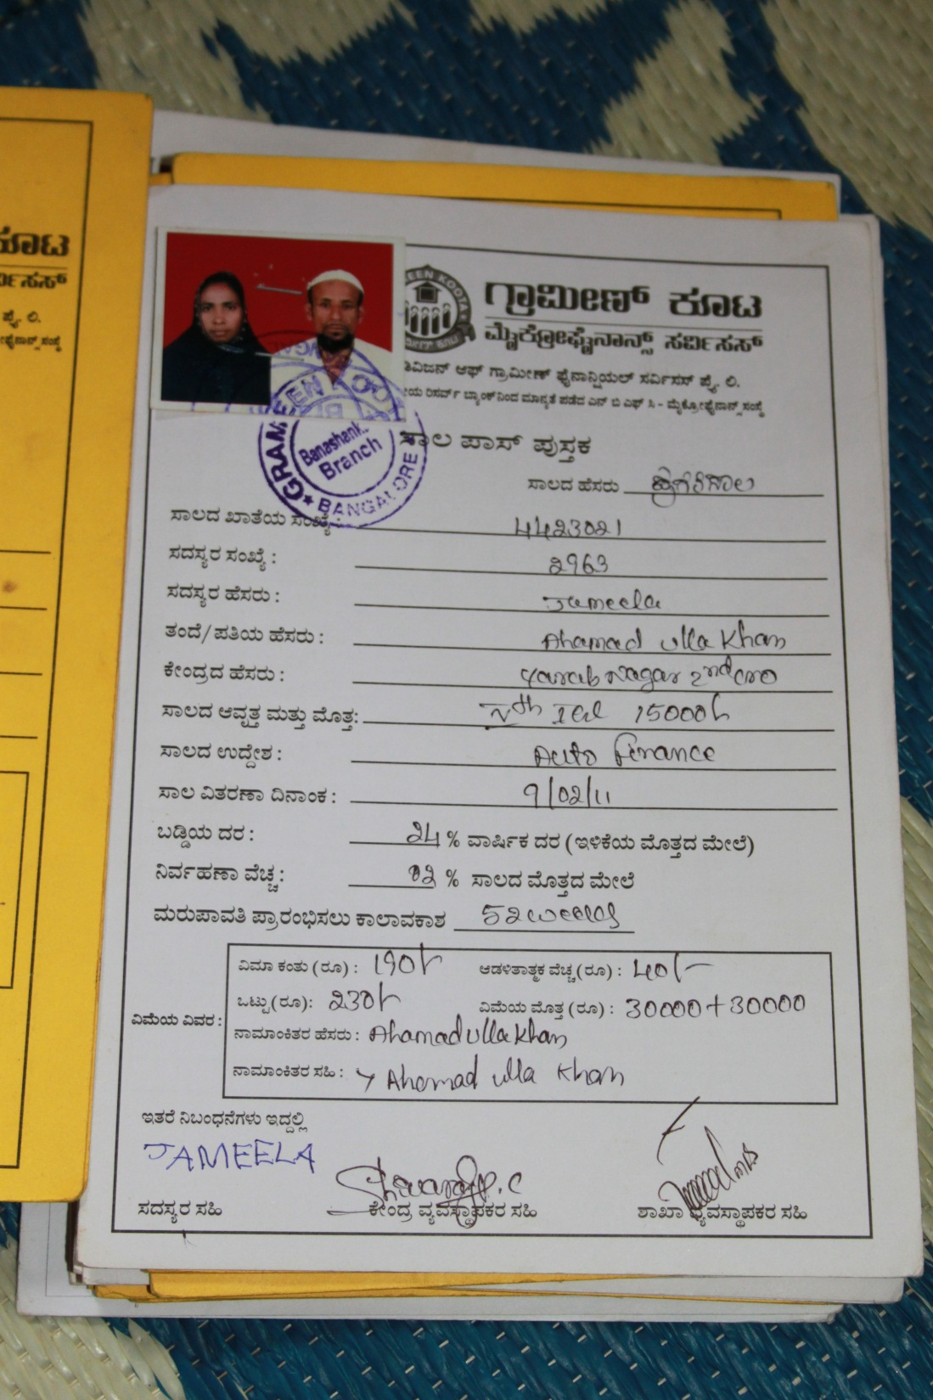
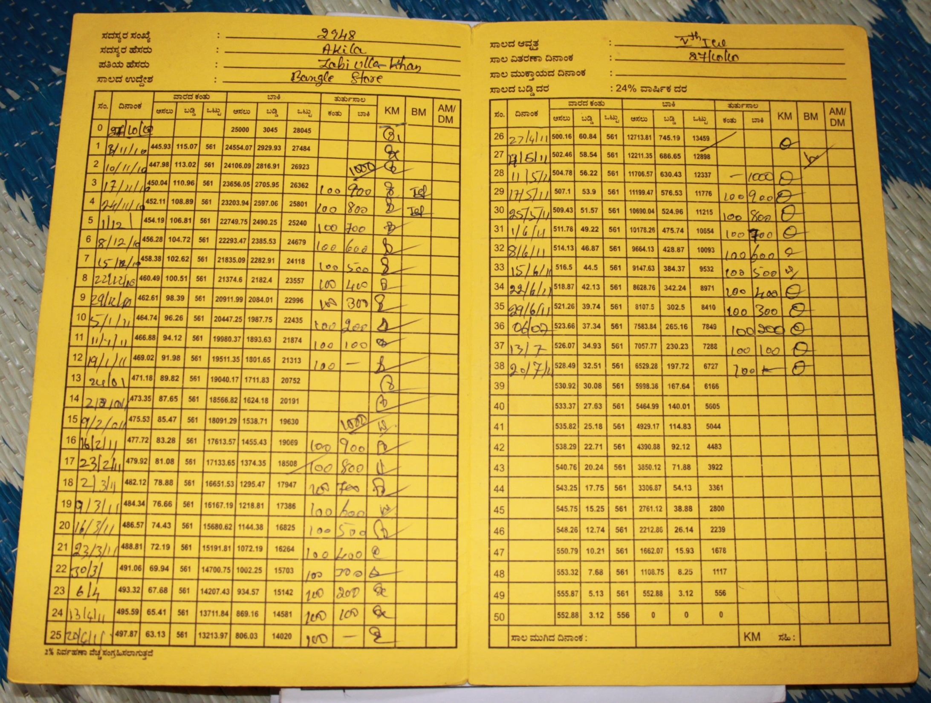
… group meeting (GK)

Slide 26
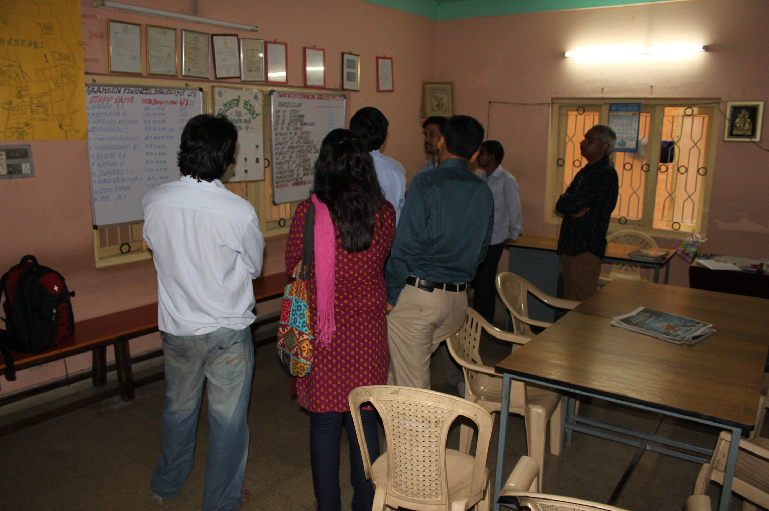
… branch of GK

Slide 27
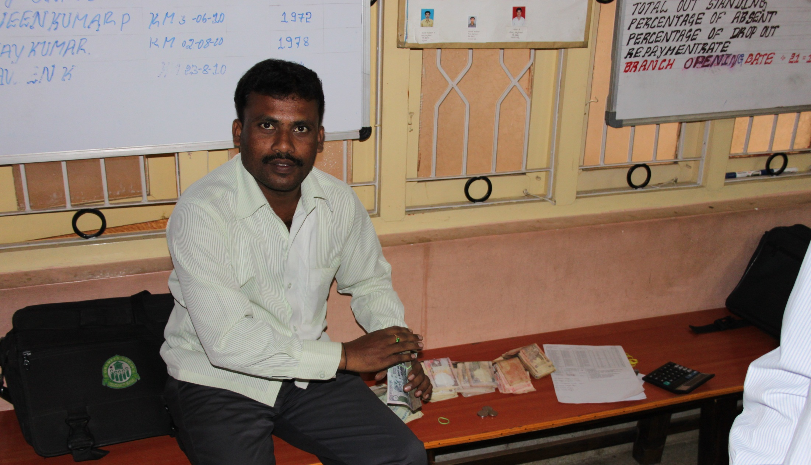
Loan Officer counting cash after returning from group meeting

Slide 28
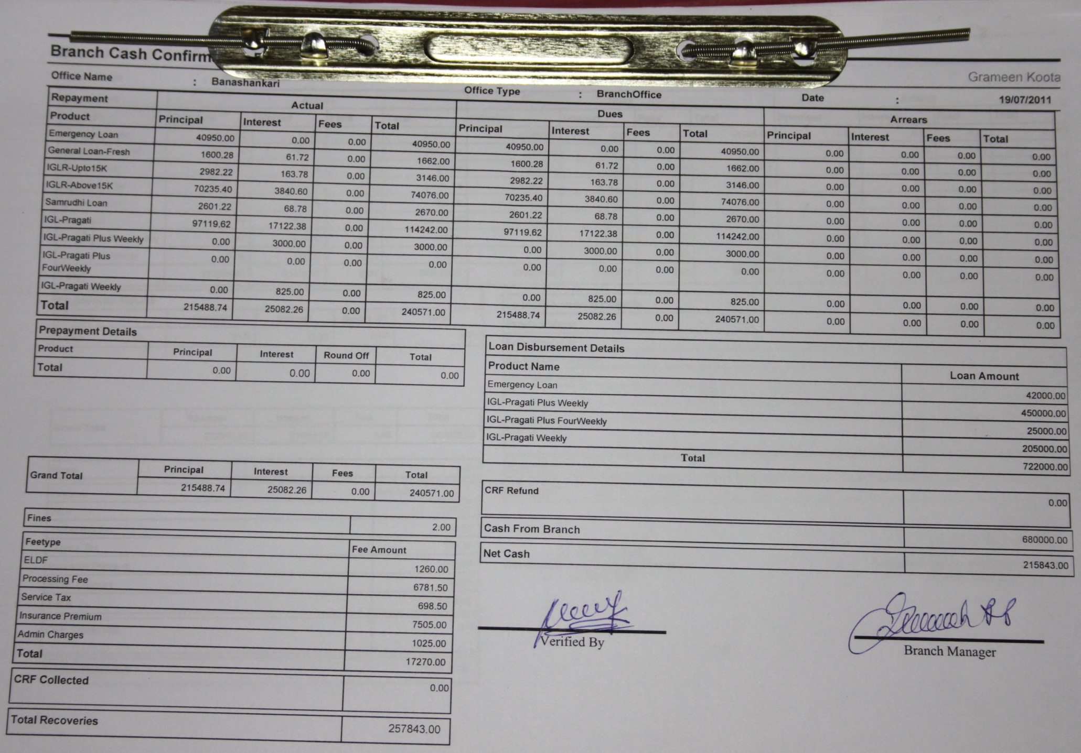
Mifos Reports (BIRT/Pentaho)

Slide 29
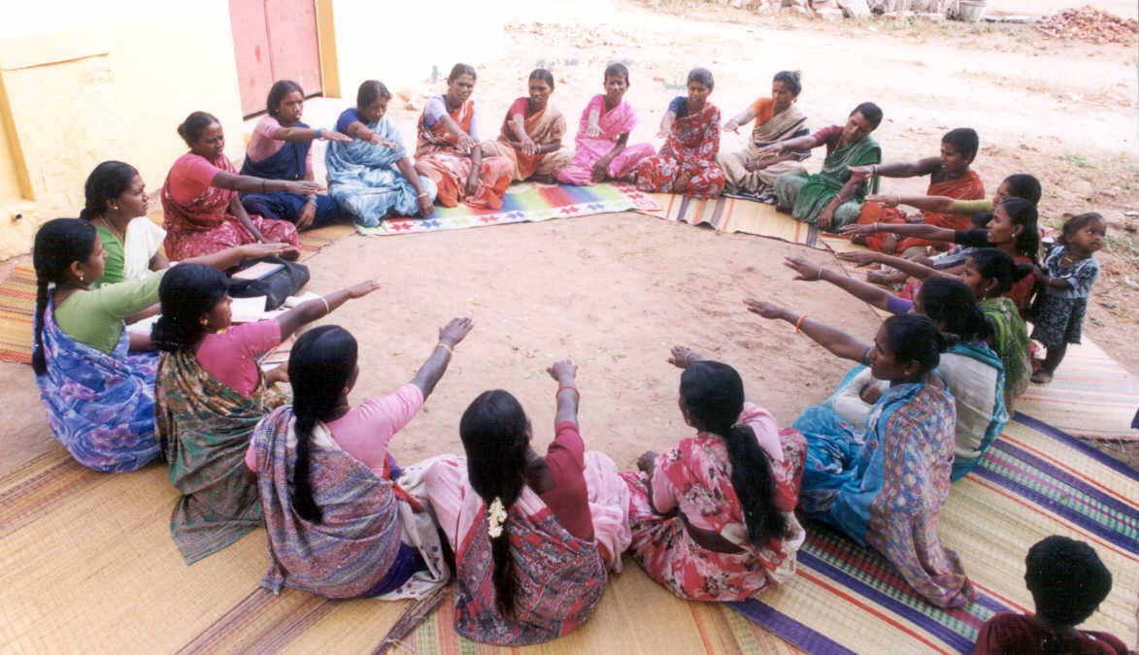

Slide 30
Technology for Microfinance
Like any business, MFIs adopt technology to:
increase operational efficiency
scale better and faster
automate thousands of manual transactions
free up loan officers to reach further out
provide security and convenience
  e.g. via mobile banking; Mifos M-Pesa interface!
know your customer (KYC), e.g. credit bureaus
lowers costs and risk
reduce paperwork
increases data integrity
…

Slide 31
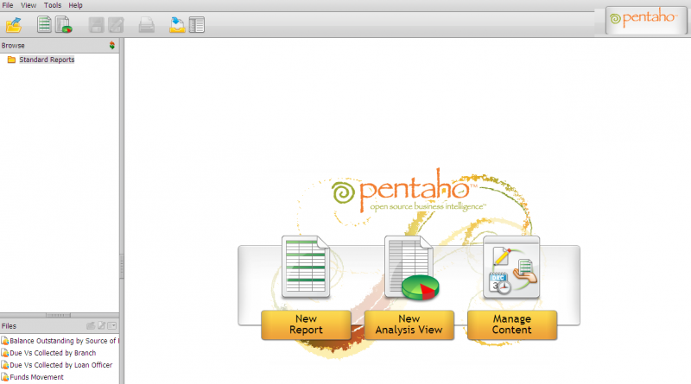
Mifos Business Intelligence Suite
Notes:
What is Mifos?
Mifos will be a complete operational platform for MFIs that is highly deployable, adaptable, and scalable for all functionality an MFI needs regardless of its size. With a platform open to innovation and extension with add-ons and plugins, the platform can be appropriate in cost, scale, features, and complexity to an MFI’s revenue, size, and sophistication—large when it needs to be large; small when it needs to be small.
Mifos is powered by technology that is open, flexible and scalable. The core platform is built on a modern framework of best in-class open source technologies creating a robust, secure, and scalable application. We will build upon this foundation with special emphasis on: provide adequate training.
Complete flexibility for any methodology in the core modules
Social performance measurement
Embedded reporting and accounting
Rapid localization
Mobile integration
Cloud hosting
Ease of installation
Seamless data integration

Slide 32
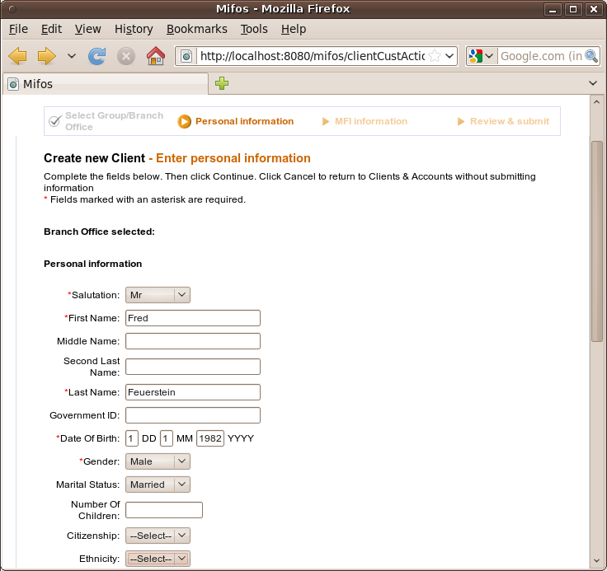

Slide 33
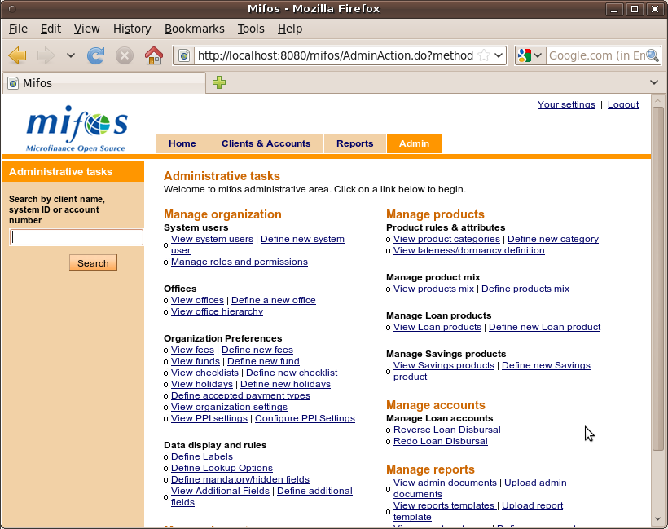

Slide 34

Mifos – open source platform
Flexible back-end system powering the MFI, connecting them to innovation worldwide as it is built by the community:
MFIs
Adapted to your Needs
Localization
Rapid configuration
Local Support
Front-End Technologies
Mobile banking
Smartcard/POS devices
Open Mifos Architecture
Flexible & Open APIs
Centralized database
Financial Modules
Mifos
Core
Systems Integration
ERP & Accounting Software
HR Systems
Configuration
Mobile Interfaces
Service Innovation
ATM/SWIFT Networks
Remittances
Insurance
Data Analytics
Reporting engine
Regulatory Compliance
Regulatory Compliance
Central Banks
Credit Bureaus
Ratings Agencies/Regulators
Transparency
Donors/Funding Sources
Social performance measurement
Notes:
Speak to why an open source platform and why it matters for MFI
They need access to local support, need to be able to localize
Need to flexibly support multiple products
Need to connect to credit bureaus, national ID systems
Need to integrate with mobile banking, atm networks, etc.
Need to report back to funders, regulators, etc.

Slide 35
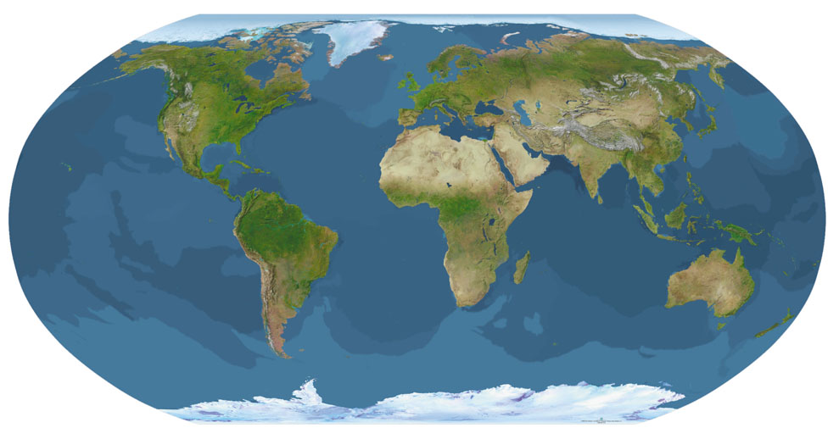
# nmap Mifos Deployments
Community:
Live In Production User
In Progress Deployment

Slide 36
Mifos Deployments
More than 850'000+ client accounts managed in Mifos deployments!
Nearly 30 MFIs in Production
  All around the world
  India – 12 MFIs
  Africa – East Africa – 8 MFIs | West Africa – 5 MFIs | So. Africa – 3 MFIs
  SE Asia , MENA
Large
  Grameen Koota (Bangalore, India) – 450,000 clients
  Enda (Tunis, Tunisia) - 140,000 clients
Small
  Creocore (Mali) – 26 clients, Nuru (Kenya) – 1,400 clients
http://mifos.org/community/whos-using-mifos

Slide 37
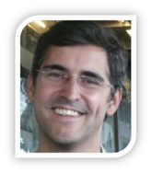
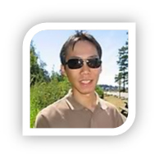

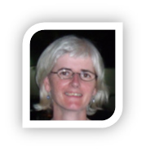
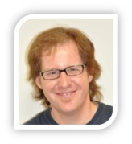
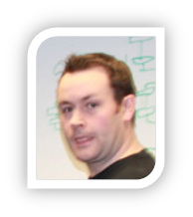
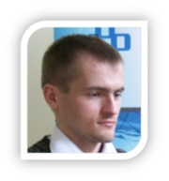
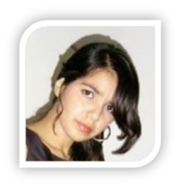

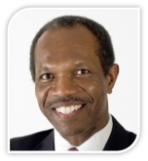
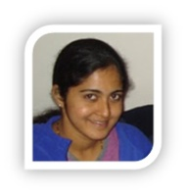
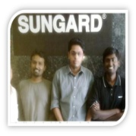
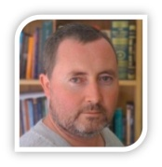
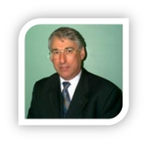
$ Mifos Star Contributors
Volunteers help fight poverty in many ways across the globe. After 5 years of stewardship and funding from Grameen Foundation, Mifos is now a fully independent community-driven project. Volunteers and supporters are needed more now than ever. You could be one of them!

Slide 38
$ cat CONTRIB
The original (2011) presentation was prepared with contributions from and reviewed by:
  Edward Cable
  Ryan Whitney
  Binny Gopinath
  Keith Woodlock
  Udai Gupta
Thank you!

